Slide 1
Entity framework: Advanced selecting
Continuous staff improvement project
Ion Gandrabura

Slide 2
Introduction
Grouping
IEnumerable vs Iqueryable
Asnotracking
SUBQueries
Projection conditionals
Dynamic filters
Pagination
Executing SQL statements and Stored procedures

Slide 3
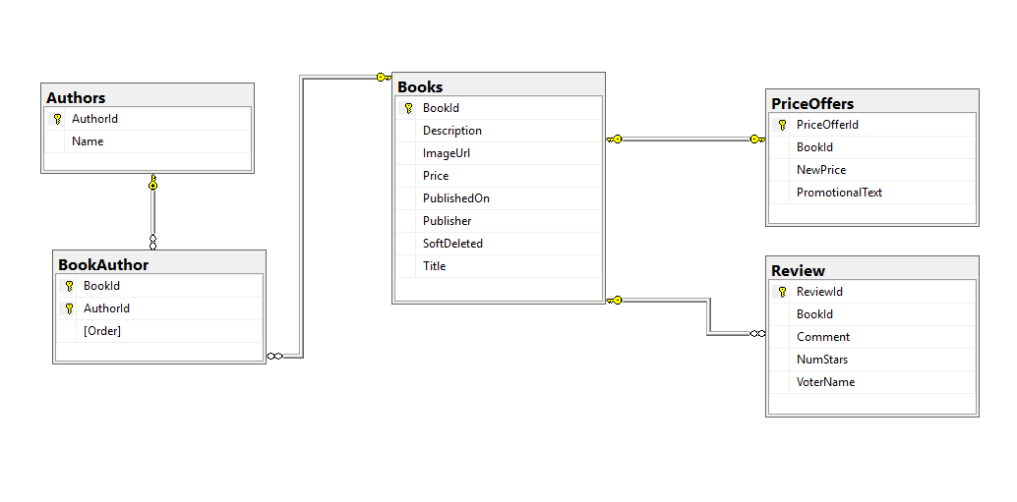
Database diagram

Slide 4
Grouping: group clause
returns a sequence of IGrouping<TKey,TElement> objects
contains zero or more items that match the key value for the group
IGrouping<TKey,TElement> objects produced by a group query are essentially a list of lists

Slide 5
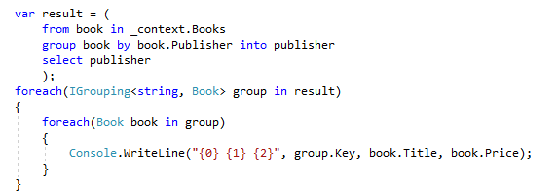
Grouping: Iterate group query result

Slide 6
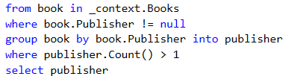
Grouping: Where vs having

Slide 7
Grouping: Aggregations
Average
Count
LongCount
Max
Min
Sum

Slide 8
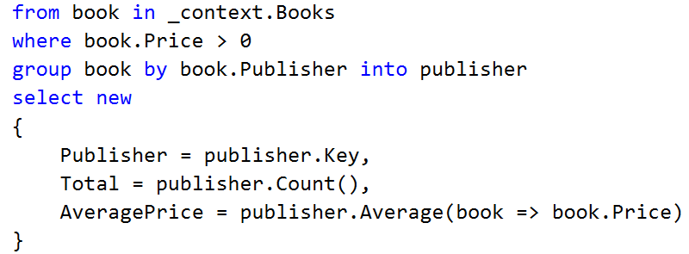
Grouping: AggregationS Example

Slide 9
GROUPJOIN
Correlates the elements of two sequences based on key equality and groups the results.
A specified IEqualityComparer<T> is used to compare keys.

Slide 10
GROUPJOIN: Syntax
public static IQueryable<TResult> GroupJoin<TOuter, TInner, TKey, TResult>(
this IQueryable<TOuter> outer,
IEnumerable<TInner> inner,
Expression<Func<TOuter, TKey>> outerKeySelector,
Expression<Func<TInner, TKey>> innerKeySelector,
Expression<Func<TOuter, IEnumerable<TInner>, TResult>> resultSelector,
IEqualityComparer<TKey> comparer
)

Slide 11
GROUPJOIN: Example
var query = context.Books.GroupJoin(
context.Reviews,
book => book.BookId,
review => review.BookId,
(book, review) => new { Book = book, Reviews = review}
);
foreach (var group in query)
{
foreach (var review in group.Reviews)
{
Console.WriteLine("{0} {1}",
group.Book.Title, review.NumStars);
}
}

Slide 12
SEleCTMANY
Projects each element of a sequence to an IEnumerable<T> and combines the resulting sequences into one sequence.
public static IQueryable<TResult> SelectMany<TSource, TResult>(
this IQueryable<TSource> source,
Expression<Func<TSource, IEnumerable<TResult>>> selector
)

Slide 13
SEleCTMANY: Example
var query = context.Books
.Where(book => book.Price > 0)
.SelectMany(book => book.Reviews);
foreach (var review in query)
{
Console.WriteLine("{0} {1}“,
review.VoterName,
review.NumStars);
}

Slide 14
Ienumerable vs Iqueryable
Both support deferred execution
IEnumerable executes select query on server side, load data in-memory on client side and then filter data.
IQueryable executes select query on server side with all filters.

Slide 15
Ienumerable vs Iqueryable

Slide 16
Asnotracking
AsNoTracking(IQueryable<TEntity>)
Returns a new query where the change tracker will not track any of the entities that are returned.
Disabling change tracking is useful for read-only scenarios
The default tracking behavior for queries can be controlled by QueryTrackingBehavior

Slide 17
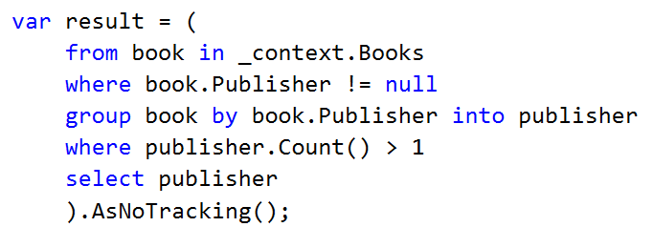
Asnotracking: Example

Slide 18
Subqueries
Use cases
As table (for joining, filtering or other operations)
For filtering (where)
For projections (select)

Slide 19
Subqueries: as table example (into)
from book in context.Books
where !book.SoftDeleted
select book into availableBook
join review in context.Reviews
on availableBook.BookId equals review.BookId
select new { Book = availableBook, Review = review }

Slide 20
Subqueries: Select example
from book in context.Books
select new
{
book.Title,
TotalReviews = book.Reviews.Count()
}

Slide 21
Subqueries: Filter example (Any)
from book in context.Books
where book.Reviews.Any(review =>
review.NumStars >= 4)
select book

Slide 22
Subqueries: Filter example (All)
from book in context.Books
where book.Reviews.All(review =>
review.NumStars >= 4)
select book

Slide 23
Subqueries: Filter example (Contains)
from review in context.Reviews
where context.Books
.Where(book => !book.SoftDeleted)
.Select(book => book.BookId)
.Contains(review.BookId)
select review

Slide 24
Projection conditionals (CASE WHEN)
from book in context.Books
select new
{
book.Title,
Status = book.SoftDeleted ? "Not available" :
"Available",
Price = book.Price > 0 ? book.Price:
book.PriceOffers.Count() > 0 ?
book.PriceOffers.First().NewPrice :
0
}

Slide 25
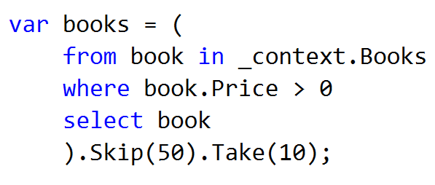
Pagination: SkiP AND TAKE

Slide 26
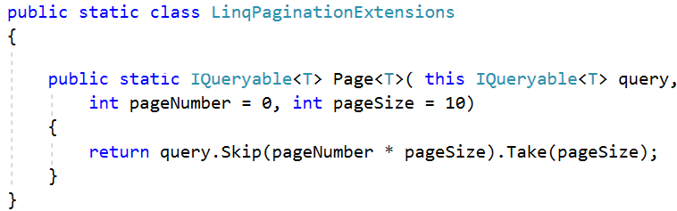
Pagination: WITH Extension methods

Slide 27
Executing SQL statements
List<DataLayer.Book> bookList =
context.Database
.SqlQuery<DataLayer.Book>(
"select * from books“
).ToList();

Slide 28
Executing Stored procedures
var idParam = new SqlParameter
{
ParameterName = "AuthorId",
Value = 12
};
List<DataLayer.Book> bookList =
context.Database
.SqlQuery<DataLayer.Book>(
"exec dbo.GetBooksByAuthorId @AuthorId",
idParam)
.ToList();

Slide 29
Assignment
Write queries using group (by multiple fields), group join, aggregations, having operators.
Write queries with different subquery types(In, Exists, Any, All)
Write queries using projection conditionals.
Write extension methods that does paginating for you.

